Slide 1

Caffeinate the City 2.0
Your guide to local coffee shops in Austin

Slide 2
Concept
Tired of Starbucks? Want to explore the culture of your city? Caffeinate the City lists the location and reviews of the local coffee shops in Austin so that you can expand your coffee horizons. By clicking on an icon near your neighborhood, Caffeinate will list shops in your area so that you can find your new favorite spot! Users can log in and rate their coffee shops, as well as leave feedback and reviews.
The motivation of this project is to push local businesses, especially in the time of covid when local businesses are struggling. They may not have the revenue for advertisement the way a corporate coffee chain would so our app draws attention to them.

Slide 3
Process
Tech used: Node.js, Express, js, Handlebars.js, MYSQL, Sequelize, HTML, CSS, Javascript, Passport, JWT
Tasks Breakdown:
Noor: Concept, front end design, CSS, front end javascript, handlebars
Justin: Concept, frond end javascript, APIS
Jason: Concept, front end javascript, APIS
Geoff: Concept, database, backend javascript, APIS
Challenges: Connection front end to back end, incorportationg handlebars, new user authentication technology
Successes: Full build of the site, working user authentication, working CSS and javascript across fron and back ends, incorporating templates

Slide 4
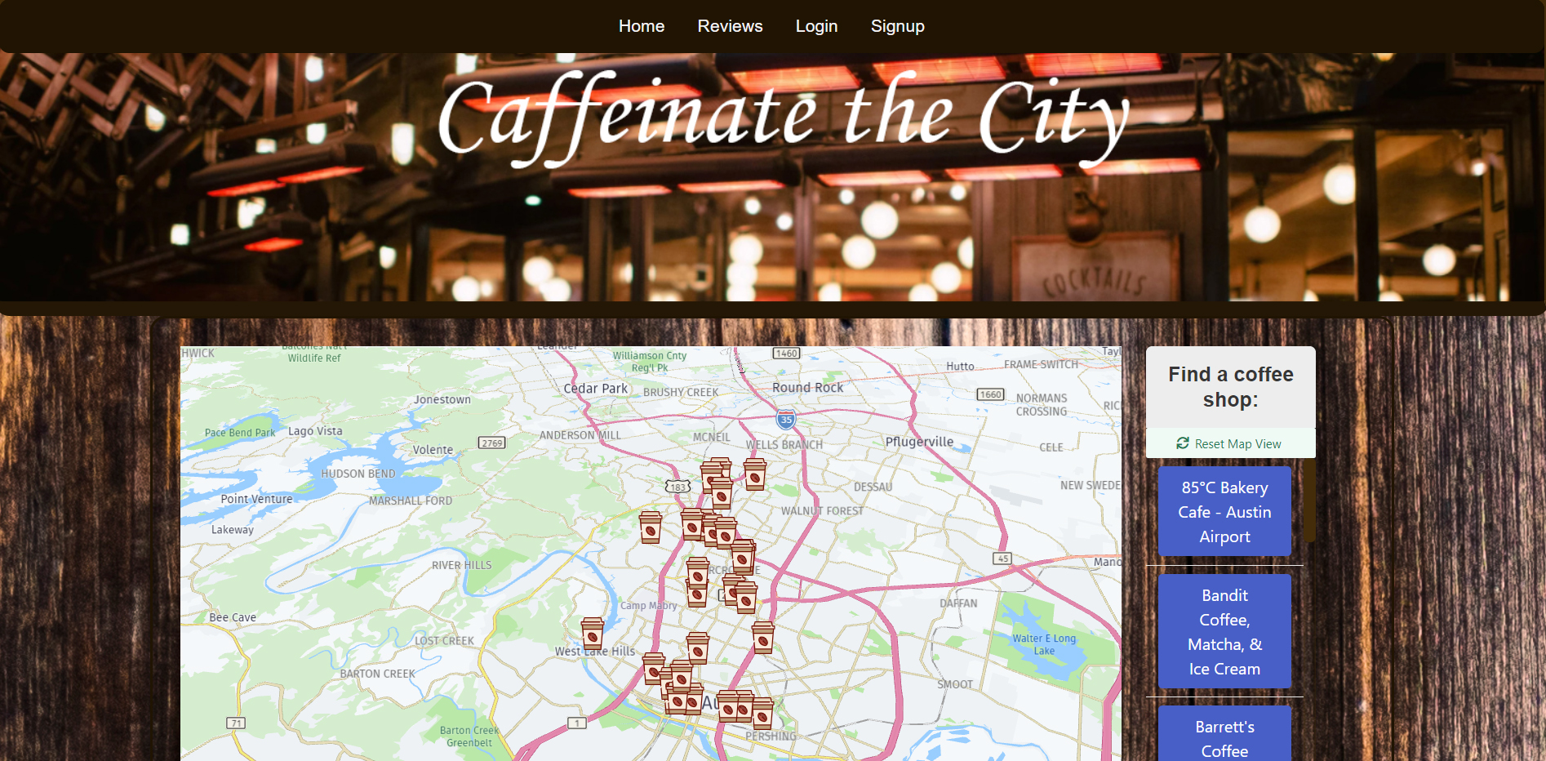

Slide 5
Directions for Future Development
Highlight new start-up coffee shops
Coffee shop of the month
Expanding to cities outside of Austin

Slide 6
Links
Deployed: Coming soon
GitHub repo: https://github.com/nalhomsi/Caffeinate-2.0

